Slide 1
Alarm System Guidelines
Kay Kasemir
Feb. 2022

Slide 2
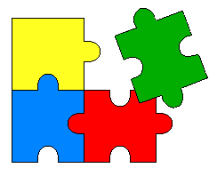
Alarm System Components
Configuration
User Interface
Alarm Server, …
Control System

Slide 3
Levels Of Complexity
Easy
Use the Alarm System
  Control Room operator
Configure the Alarm System
  Certain operators, IOC engineers
Alarm System Setup
  CS-Studio maintainer for site
Coming up with a good configuration
  Everybody
Hard

Slide 4

Creating a good Alarm Configuration
Hard
B. Hollifield, E. Habibi,
"Alarm Management:
Seven Effective Methods
for Optimum Performance", ISA, 2007

Slide 5
Alarm Philosophy
Goal:
Help operators take correct actions
  Alarms with guidance, related displays
  Manageable alarm rate (<150/day)
  Operators will respond to every alarm
  (corollary to manageable rate)

Slide 6
What’s a valid alarm?
DOES IT REQUIRE
IMMEDIATE OPERATOR ACTION?
  What action? Alarm guidance!
    Not “make elog entry”, “tell next shift”, …
  Consequence of not reacting?
  How much time to react?

Slide 7
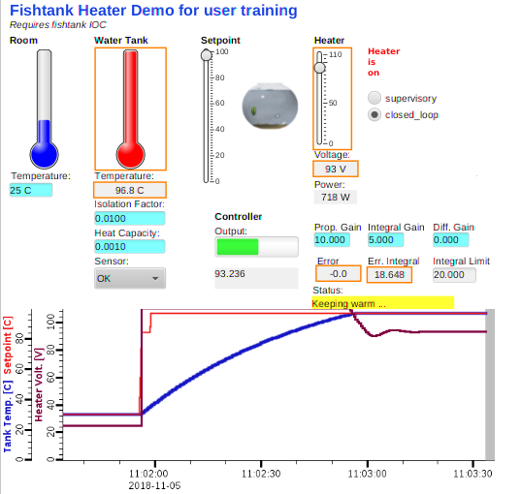
Fishtank Example
Heater Voltage alarms at high PID drive
Tank Temperature alarms at
70 (MINOR) and 100 (MAJOR)
Which one is a good alarm trigger PV?

Slide 8
How are alarms added?
Alarm triggers: PVs on IOCs
  But more than just setting HIGH, HIHI, HSV, HHSV
  HYST is good idea
  Dynamic limits, enable based on machine state,...
  Requires thought, communication, documentation
Added to alarm server with
  Guidance: How to respond
  Related screen: Reason for alarm (limits, …), link to screens mentioned in guidance
  Link to rationalization info (wiki)

Slide 9
Example: Elevated Temp/Press/Res.Err./…
Immediate action required?
  Do something to prevent interlock trip
Impact, Consequence?
  Beam off: Reset & OK, 5 minutes?
  Cryo cold box trip: Off for a day?
Time to respond?
  10 minutes to prevent interlock?
  ⬇
MINOR? MAJOR?
Guidance: “Open Valve 47 a bit, …”
Related Displays: Screen that shows Temp, Valve, …

Slide 10
Avoid Multiple Alarm Levels
Analog PVs for Temp/Press/Res.Err./…:
  Easy to set LOLO, LOW, HIGH, HIHI
Consider:
  Do they require significantly different operator actions?
  Will there be a lot of time after the HIGH to react before a follow-up HIHI alarm?
In most cases, HIGH & HIHI only double the alarm traffic
  Set only HSV to generate single, early alarm
  Adding HHSV alarm assuming that the first one is ignored only worsens the problem

Slide 11
Water Tower, Bad Example
Level < 30%: Minor/Low Alarm
“Try to raise water level”
Level <25%: Major/LoLo Alarm
“Really, try to raise the water level NOW”
➔ Nearly same reason and guidance, should be one alarm

Slide 12
Water Tower, Better Example
Level < 50%: Minor/Low Alarm
“Check if auto-topup pumps which should keep water level above 50% are running. If they are, try to reduce water consumption by disabling unnecessary users like lawn sprinkler and guest house water feature. If they aren’t, call Fred @ 567-987”
Level <25%: Major/LoLo Alarm
“Water level is approaching minimum required for fire suppression systems. Perform fast machine shutdown, procedure 4812, and inform operations leader.”

Slide 13
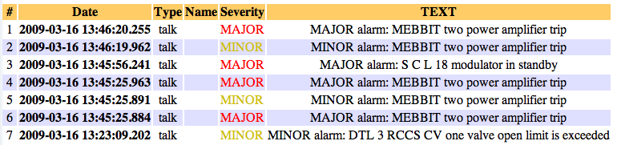

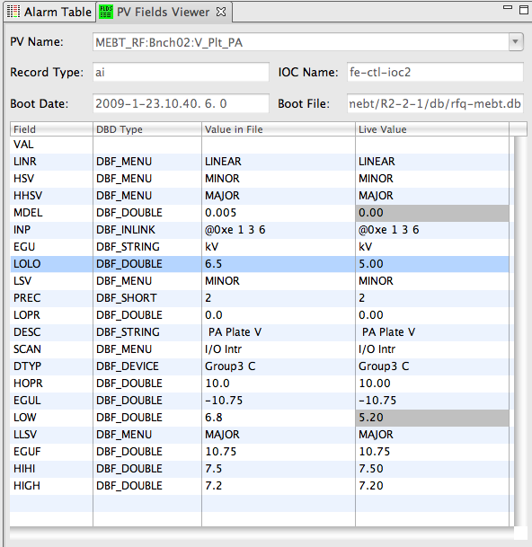
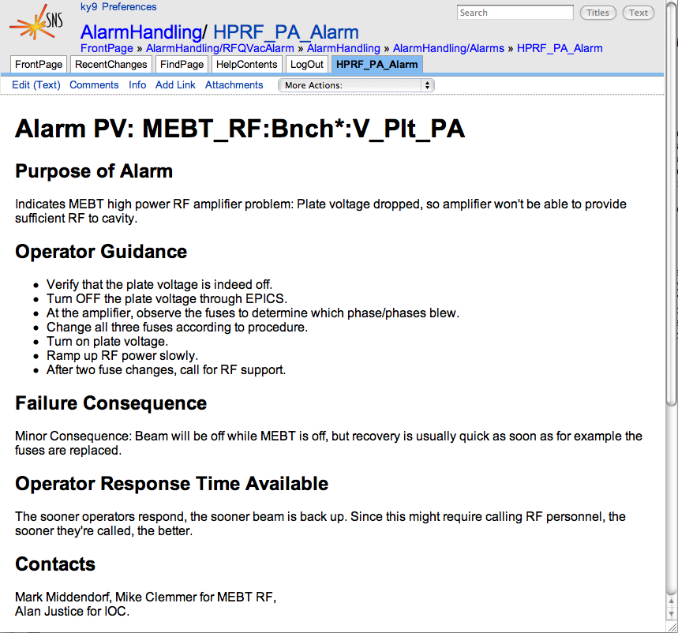
Bad Example: Old SNS ‘MEBT’ Alarms
Each amplifier trip:
3 quasi identical alarms,
no guidance
Rethought w/ subsystem
engineer, IOC programmer
and operators: 1 better alarm

Slide 14
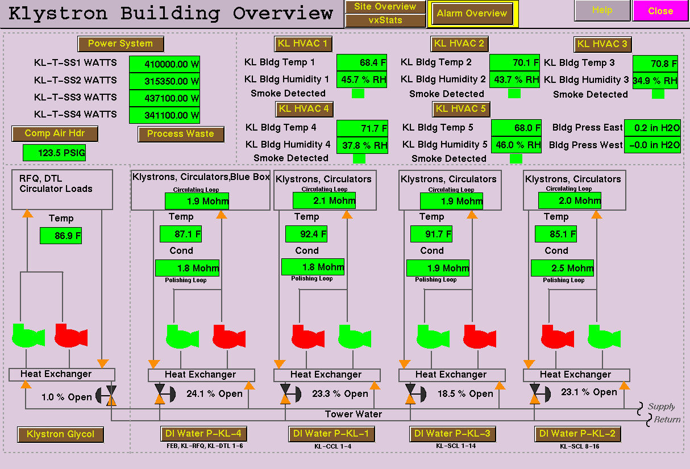
Alarms for Redundant Pumps

Slide 15
Alarm Generation: Redundant Pumps the wrong way
Control System
  Pump1 on/off status
  Pump2 on/off status
Simple Config setting: Pump Off => Alarm:
  It’s normal for the ‘backup’ to be off
  Both running is usually bad as well
    Except during tests or switchover
  During maintenance, both can be off

Slide 16
Redundant Pumps
Required Pumps:
1
Control System
  Pump1 on/off status
  Pump2 on/off status
  Number of running pumps
  Configurable number of desired pumps
Alarm System: Running == Desired?
  … with delay to handle tests, switchover
Same applies to devices that are only needed on-demand

Slide 17
Create Alarms in PLC or in IOC?
# Read just the value
record(ai, “plc_value”)
{
field(DTYP, “EtherIP”)
field(INP, “@plc tags[42]”)
}
# Get alarm indicator from PLC
# and turn into MINOR alarm
record(bi, “plc_alarm”)
{
field(DTYP, “EtherIP”)
field(INP, “@plc alarms[42]”)
field(OSV, “MINOR”)
}
# Optionally, expose the alarm threshold
# Omit this to hide that in the PLC
record(ai, “plc_threshold”)
{
field(DTYP, “EtherIP”)
field(INP, “@plc limits[42]”)
}
# All in one record
record(ai, “plc_value”)
{
field(DTYP, “EtherIP”)
field(INP, “@plc tags[42]”)
field(HIGH, “95”)
field(HSV, “MINOR”)
field(HYST, “5”)
}

Slide 18


Create Alarms in PLC or in IOC?
“In IOC is simpler, plus allows knowledgeable users to see configuration (HIGH, HYST, ..) and even change it”
“You’re right, but interlocks are not alarms. Keep your interlocks in the PLC and show the status via records. Use the IOC for alarms that are meant to help operators, which operators might have to adjust”
“But this is an important interlock, it’s handled by the PLC, and nobody should be able to change it from the outside”

Slide 19
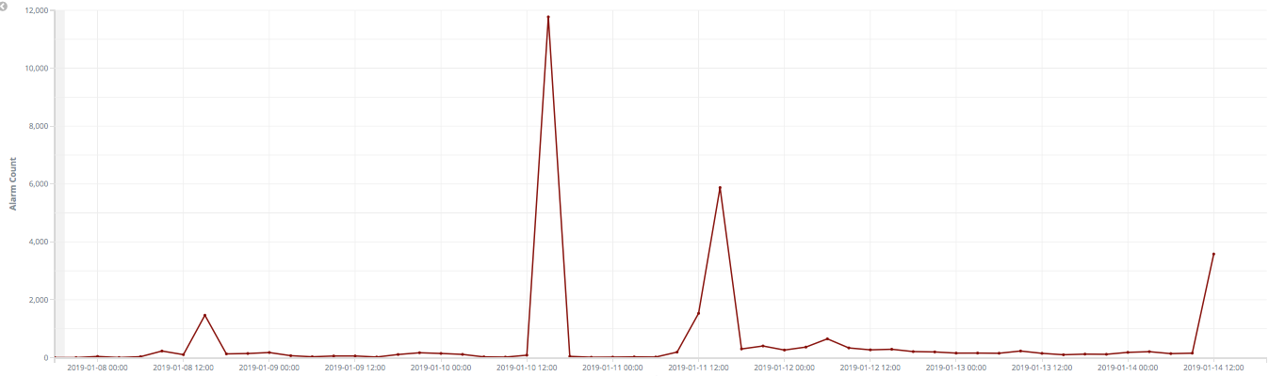
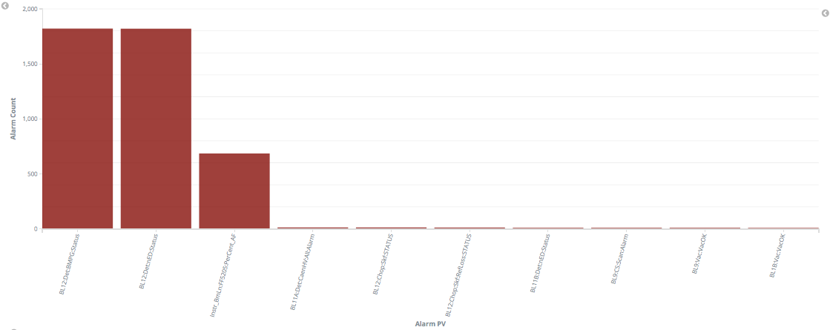
Review: How Many alarms in last week?
Top 10 in last 24 h?

Slide 20
Suggested Roles
Alarms should help operators take correct actions
  ➔ Operators can disable alarms, update guidance
  ➔ Operations leader adds trigger PVs to alarm system,
  with guidance and display links
Subsystem expert can suggest alarms, describe their purpose and guidance for handling them
Control system engineer creates/configures PVs and displays

Slide 21
Summary
Easy to use
  Check alarms in Table, Tree, Panel
  Fix it: Read Guidance, use Display Links
  ✔Acknowledge
Configuration
  Can be changed online
  Operators can update guidance,
  add better display links
Alarm System Setup
  Somewhat Involved, but only once
Producing a good configuration
  Hard, never ending
Easy
Hard

